Slide 1
SWEDA A S
PSG institute of technology and applied research
B.E computer science and engineering, 3rd year.
REG NO: 715521104049
Email ID: sweda2004@gmail.com
NM ID: 336612FAD4217B1B089411E11C6B41E2

Slide 2
PROJECT TITLE
SIGN LANUGUAGE RECOGNITION
WITH
GENERATIVE ADVERSIAL NETWORK

Slide 3


AGENDA
Problem Statement
Project Overview
End Users
Solution & Value Proposition
Modelling Approach
Results
Conclusion
3/21/2024 Annual Review

Slide 4

PROBLEM STATEMENT
Sign language serves as a primary mode of communication for the deaf and hard of hearing community, yet existing recognition systems often suffer from limitations in accuracy, real-time processing, and adaptability to diverse gestures and expressions.
Therefore, there is a need to develop a robust sign language recognition system that utilizes advanced techniques such as Generative Adversarial Networks (GANs) to accurately interpret sign language gestures in real-time, thereby bridging communication gaps and enhancing accessibility for the deaf community.
3/21/2024 Annual Review

Slide 5

PROJECT OVERVIEW
Objective: Develop a sign language recognition system using Generative Adversarial Networks (GANs) implemented with keras.
Approach:
Dataset Preparation: Utilize sign language datasets or adapt existing datasets to represent sign language gestures.
GAN Implementation: Implement a GAN architecture using Keras, comprising generator and discriminator networks for generating and recognizing sign language gestures.
Training Process: Train the GAN model on the sign language dataset to learn the mapping between gestures and labels.
Real-time Recognition: Deploy the trained GAN model for real-time recognition of sign language gestures from real-time inputs.

Slide 6

WHO ARE THE END USERS?
Deaf and Hard of Hearing Individuals: Primary users of the system, enabling effective communication through sign language in various contexts.
Interpreters and Educators: Benefit from enhanced communication and teaching capabilities, aiding in training and improving sign language proficiency.
Accessibility Advocates and Organizations: Groups that work to make sure everyone, including those who are deaf or hard of hearing, can access information and services.

Slide 7
YOUR SOLUTION AND ITS VALUE PROPOSITION
The solution leverages Generative Adversarial Networks (GANs) implemented with Keras to develop a robust sign language recognition system.
VALUE PROPOSITION:
Accurate Recognition: Our system accurately detects and interprets sign language gestures, enabling seamless communication.
Real-time Processing: Capable of processing video inputs in real-time, ensuring timely recognition and response.

Slide 8

THE WOW IN YOUR SOLUTION
Genuine Gesture Production: This method produces realistic sign language gestures that closely mimic hand movements, improving user immersion and recognition accuracy.
Adaptive Learning: Leveraging the power of GANs and Keras in a Colab environment, the solution employs adaptive learning techniques. It continuously learns and adapts to user interactions, refining its recognition capabilities over time.

Slide 9
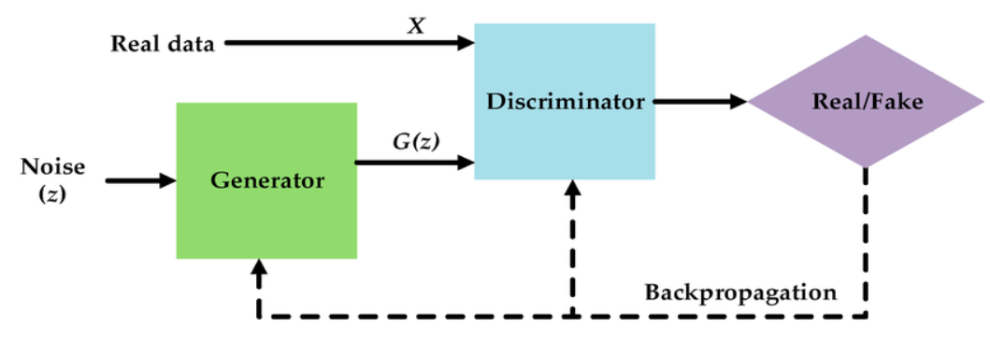
MODELLING
GAN Model:
Architecture: The GAN model combines the generator and discriminator networks.
Training: The GAN is trained in an adversarial manner, where the generator aims to deceive the discriminator by generating realistic sign language gestures, while the discriminator learns to distinguish between real and generated gestures.

Slide 10
MODELLING…
Generator Model:
Architecture: The generator model consists of multiple dense layers with ReLU activation functions, followed by a final layer with a hyperbolic tangent activation function to generate images.
Training: The generator is trained to generate realistic sign language gestures from random noise input.
Discriminator Model:
Architecture: The discriminator model comprises dense layers with ReLU activation functions and dropout layers to prevent overfitting.
Training: The discriminator is trained to distinguish between real and generated sign language gestures.

Slide 11
MODELLING…
Training Process:
Loss Functions: Both the generator and discriminator are trained using binary cross-entropy loss functions.
Optimization: Adam optimizer is used for training both the generator and discriminator networks.
Hyperparameters: Learning rate, beta parameters, and dropout rates are tuned to optimize the training process.
Evaluation:
Performance Metrics: The performance of the models is evaluated using metrics such as loss values, accuracy, and visual inspection of generated sign language gestures.
Validation: The trained models are validated using separate test datasets to assess their generalization ability.

Slide 12
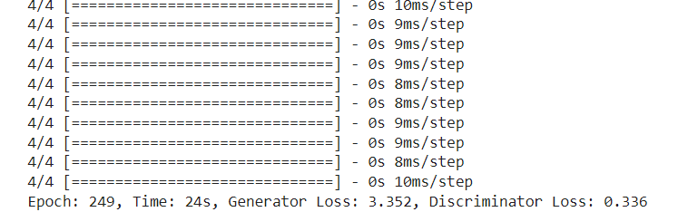
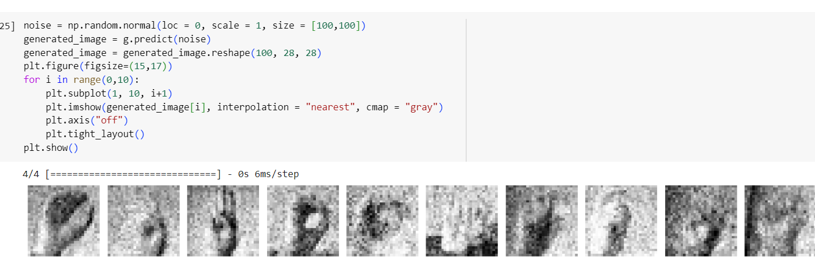
RESULTS

Slide 13
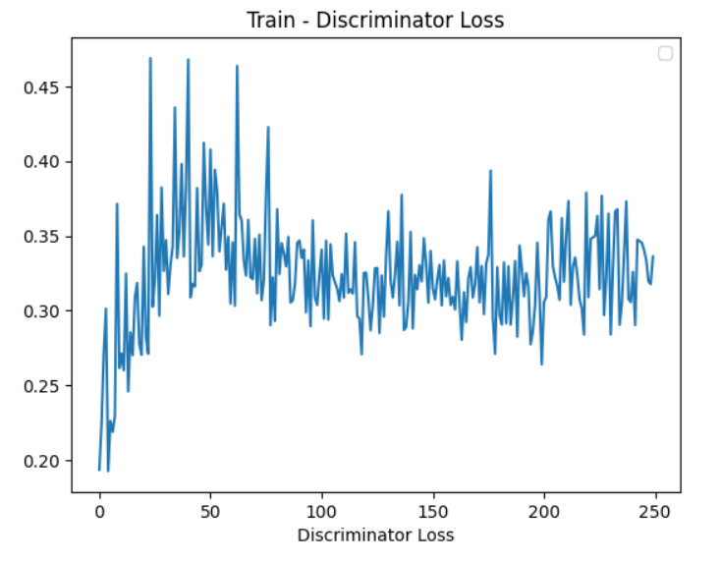
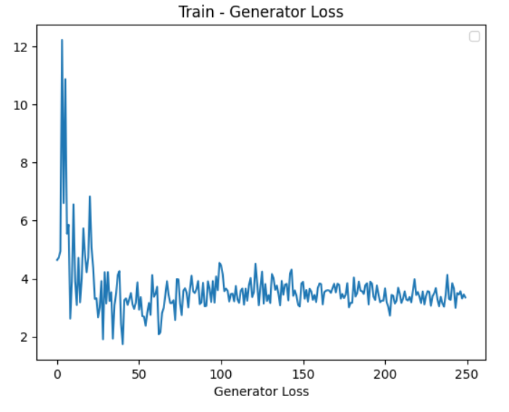
RESULTS

Slide 14
CONCLUSION
The project demonstrates the effectiveness of GAN technology in recognizing sign language gestures. This development demonstrates how technology can close communication gaps and promote inclusivity, making communication more accessible for people who use sign language.
REFERENCES
https://en.wikipedia.org/wiki/Generative_adversarial_network
https://keras.io/
https://www.kaggle.com/datasets/datamunge/sign-language-mnist

